Slide 1










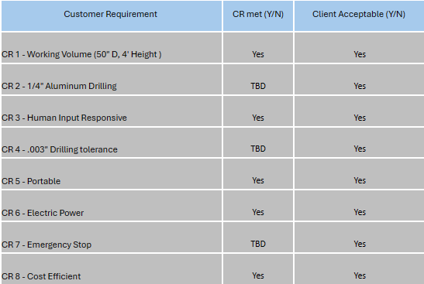
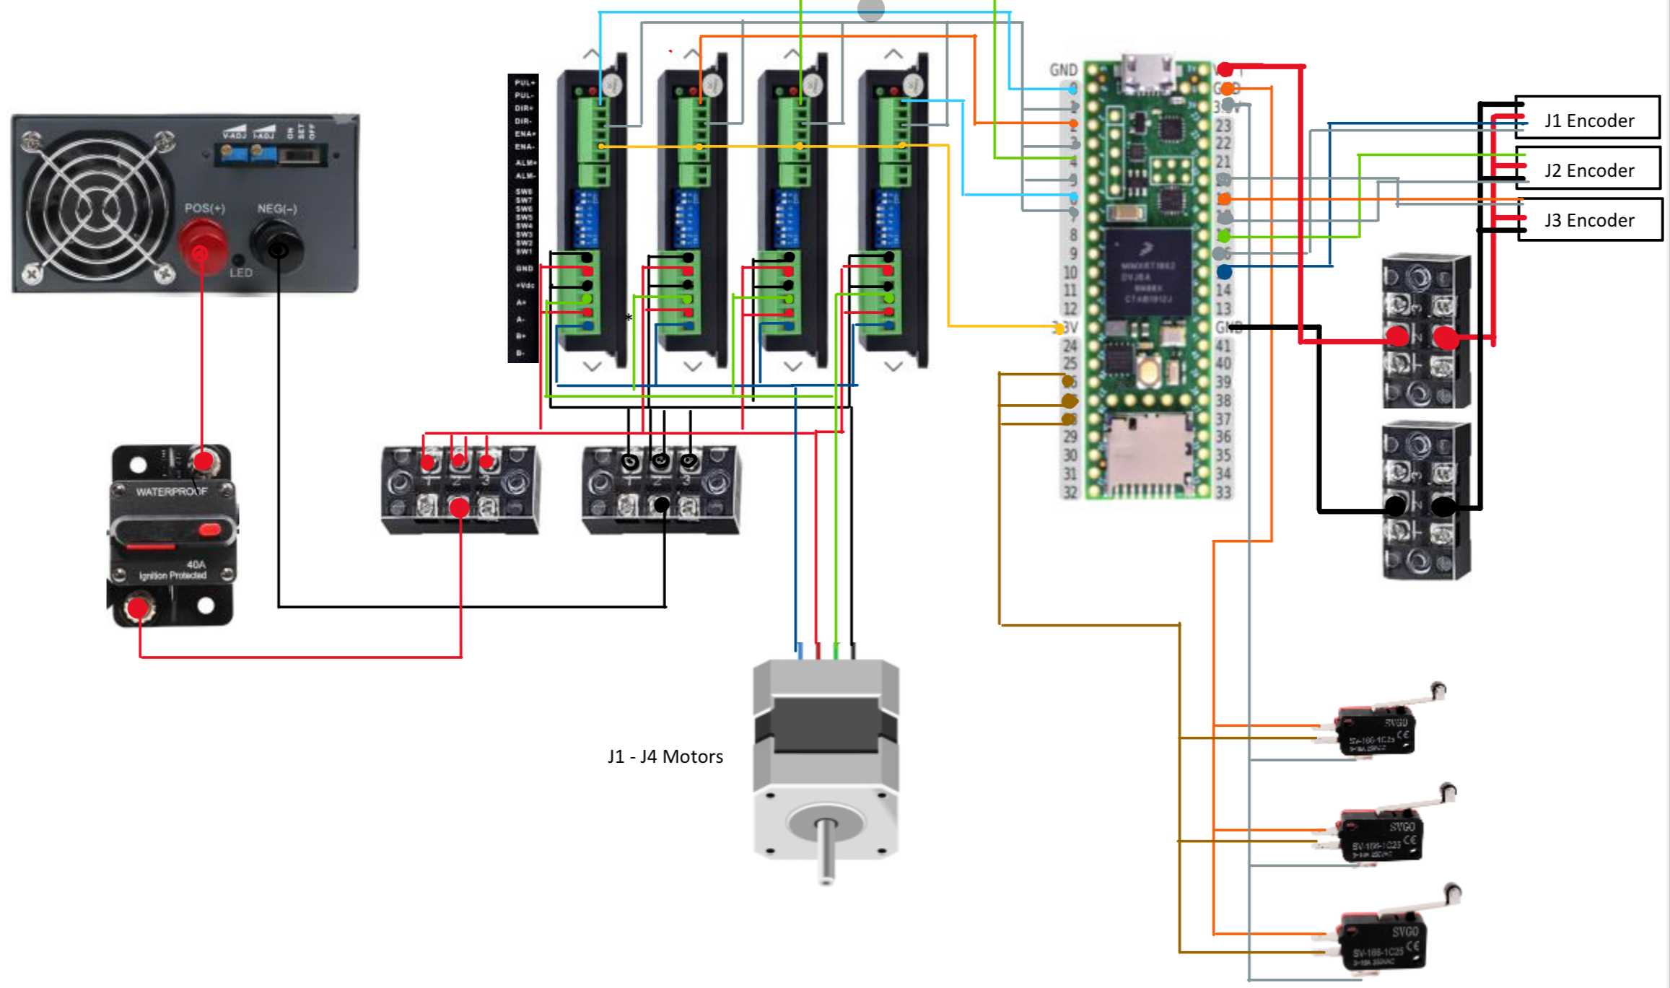
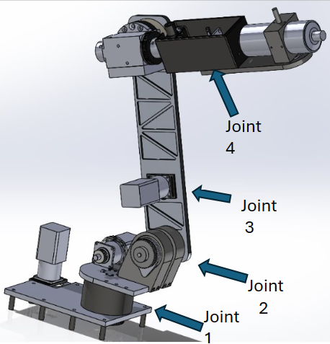
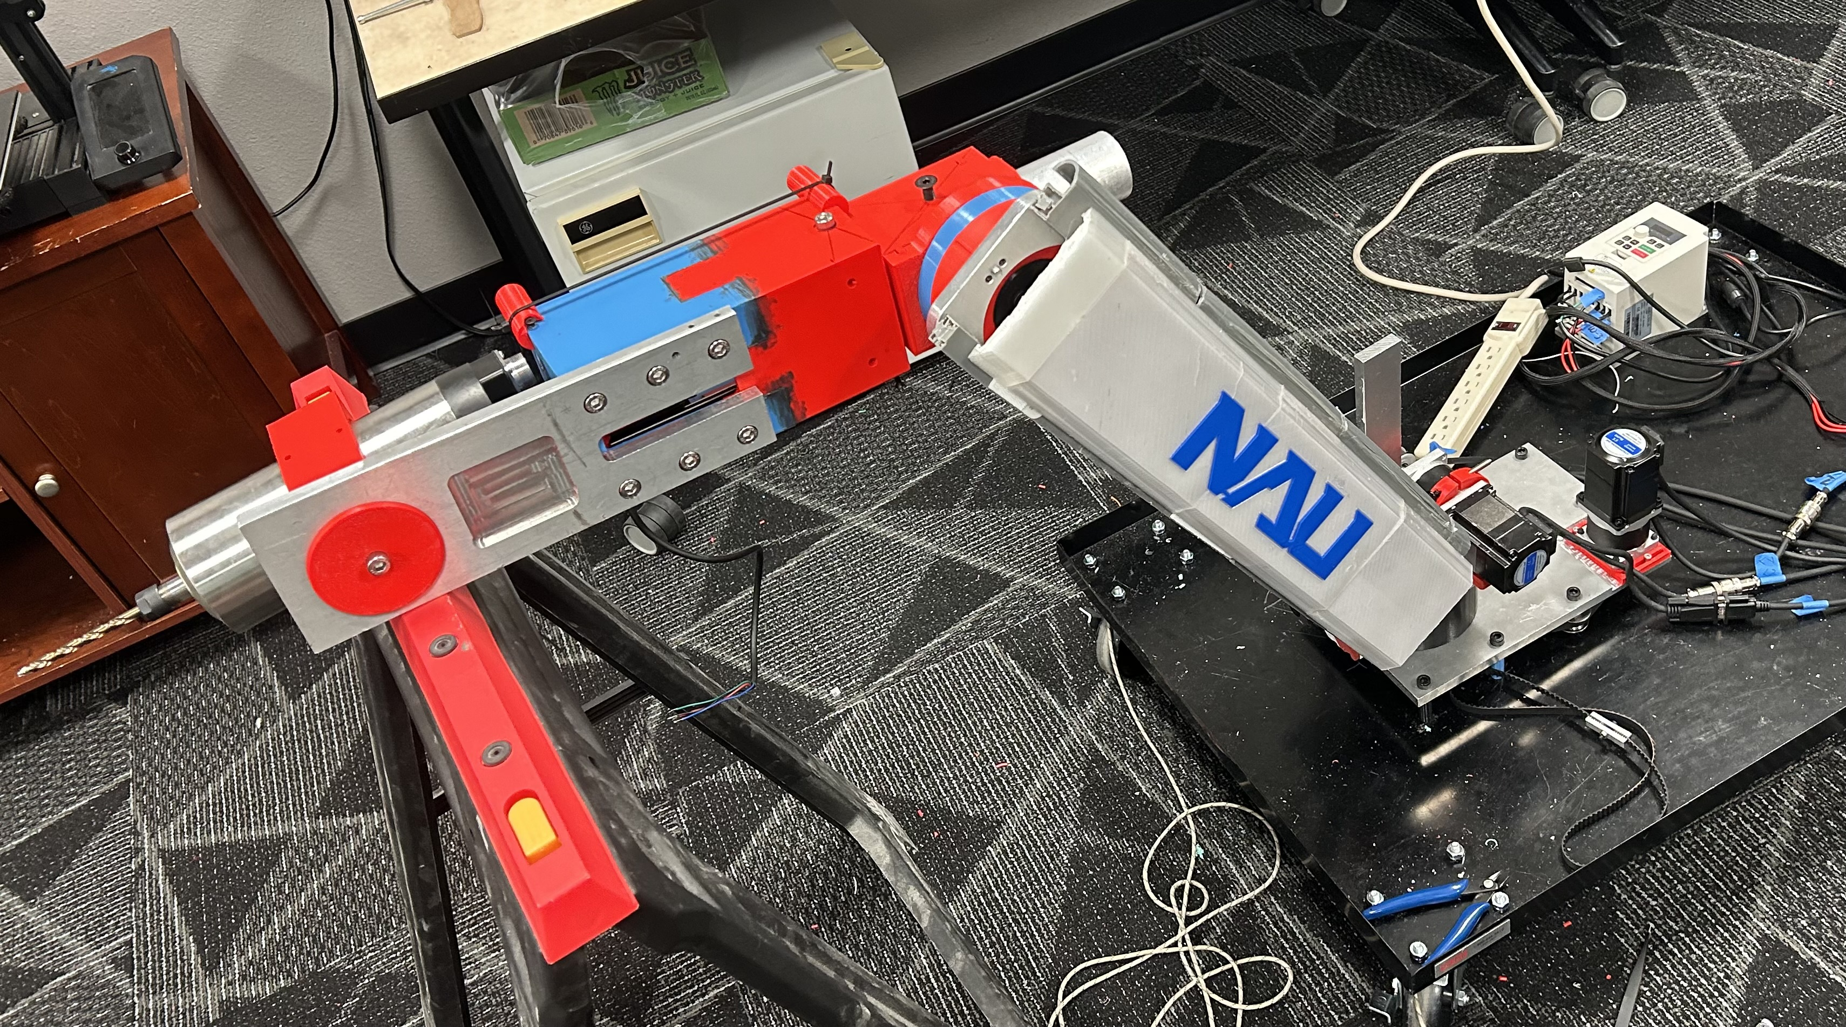
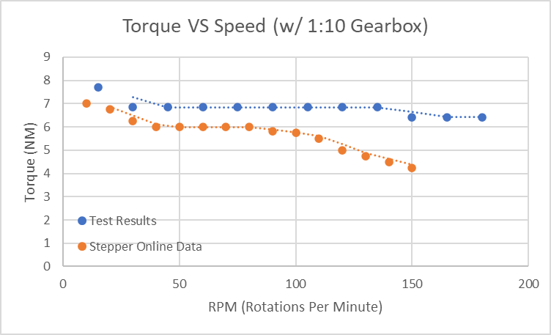
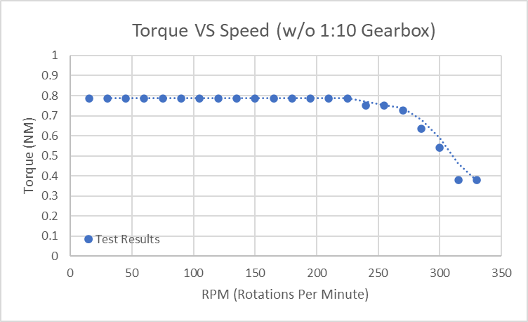
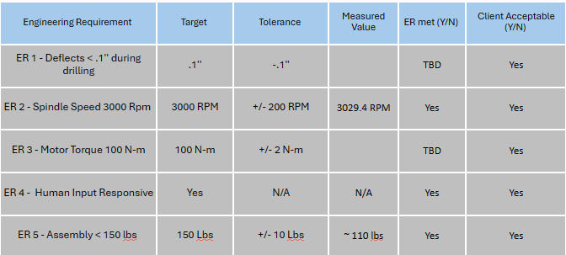
Northrop Grumman Five DOF Robotic Drilling Arm for Launch Vehicle Components
Brandon Knutson
Isaiah Padilla
Mica Nellis
Daniel Cooke
Russel Stringham
Mason Goodman
Department of Mechanical Engineering, Northern Arizona University, Flagstaff, AZ 86011
Abstract
Methods
Conclusion
Northrop Grumman Space Systems initiated a project aimed at developing a five degree of freedom robotic drilling arm capable of precisely locating drilling positions on the internal surface of a composite cylinder; crucial for assembling their launch vehicles. The drilling arm must account for varying cylinder sizes and materials while ensuring it can generate enough force to penetrate the targeted material, specifically aluminum in this instance. With a budget of $10,000, the NAU NG Drill Arm Team’s response was to perform market research and reference pre-existing five degree of freedom (DOF) robotic arms to create a design which would fit the working volume requirements. The client specified that the end effector must reach all points on the internal surface of a cylinder that is four feet tall and 50 inches in diameter. The drilling operation will occur perpendicular to the drilling surface. The final product will be capable of being programmed by an on-site operator, who would designate the hole locations, and the end effector will complete the desired drilling operation without any further human interference. This will allow NG to drill holes with efficiency and precision into any manufactured parts that require the operation. The collective objective is to provide an innovative and efficient solution which can be feasibly integrated into Northrop Grumman’s in-house operations.
Design
5 DOF design was inspired by the AR4-MK2 robotic arm produced by Annin Robotics [1].
Open-source part files and programming software provided by Annin Robotics were modified to meet design requirements [1]
Structural components manufactured from 6061 Aluminum and polylactide (PLA) printing
Magnetically encoded, geared stepper motors controlled by Arduino Mega dictate the movement of an air-cooled spindle [5]
Testing
Experiments designed to evaluate the product's performance based on the success metrics defined by customer requirements
Torque-speed curves developed to evaluate motor and gearbox efficiencies
Refined motor displacement test conducted to limit the range of motion of each axis of rotation [5]
Real World Simulation: Robot must drill two, square bolt hole patterns in ¼'' aluminum plates at varying heights without any maintenance or intervention [5]
Figure 1: Wiring Diagram
Results
Requirements
Figure 2: Torque-Speed Curve with Gearbox Figure 3: Torque-Speed Curve no Gearbox
Table 1: Testing Results
The end effector must be able to reach all points in a cylindrical working volume that is four feet tall and 50'' in diameter
The drill or spindle must spin at a minimum of 3000 rotations per minute.
The end effector must push the drill bit against the drilling surface with a minimum force of 55 Newtons.
The joint motors must be able to supply 100 N-m of torque to its respective joint.
The robot must be human input responsive (HIR).
The entire assembly must weigh no more than 150 pounds.
The entire assembly must be portable, capable of being moved by two people.
The entire project must less than $5,000, with the opportunity for the budget to be raised to $10,000.
Drill bits must be able to withstand 10 jobs per day before replacement.
All other robot arm elements and hardware must be able to withstand 70 total jobs before replacement or routine maintenance.
Drilling must meet a minimum tolerance of .003 inches.
The drill tip must not exceed a maximum deflection of more than .1 inches to be client acceptable.
Figure 4: Final CAD Model
Figure 5: Final Prototype
References
[1] C. Annin, “AR4-MK2 Robot Manual.” Annin Robotics, Jan. 21, 2024
[2] T. Xometry, “Drilling machines - parts, types, and uses,” Xometrys RSS, https://www.xometry.com/resources/machining/drilling-machines/ (accessed Sep. 15, 2023).
[3]“A-Z guide for Drilling Aluminium | RUKO Shop UK,” RUKO UK, Nov. 07, 2023. https://ruko.shop/blogs/ruko-shop-blog/drilling-aluminium-guide#:~:text=A%20regular%20HSS%20drill%20bit
[4] R. G. Budynas and J. K. Nisbett, “Chapter 4 - Deflection and Stiffness,” in Shigley’s Mechanical Engineering Design, 11th edition, SI units, 11th ed, S.l., NY: MCGRAW-HILL EDUCATION (AS, 2020, pp. 173–219
[5] M. McCauley, “AccelStepper: AccelStepper library for Arduino,” www.airspayce.com. https://www.airspayce.com/mikem/arduino/AccelStepper/
‌
Acknowledgements
This project is sponsored by Northrop Grumman Space Systems, with direct advisory from Aeronautical Engineers Arjun Banerji and Andrew Acosta. The team was supervised by NAU Undergraduate Professor for Mechanical Engineering, David Willy throughout the entire design and manufacturing process. Inspiration for this design can be credited to Annin Robotics.

